Slide 1
Facts in correction of ametropia
Gamal Abdellatief Radwan, MD

Slide 2
The provision of spectacles to correct vision is based on both science and art so every ophthalmologist should be armed with knowledge and supplemented by clinical experience to attain competency in providing optimal visual correction for each patient

Slide 3
Optical principles
Object / Image conjugacy in ametropic eyes.
Far point and optical corrections.
Lens effectivity.
Effect of changing lens position

Slide 4
Object / Image conjugacy in ametropic eyes
An object and the image of that object created by an optical system are said to be conjugate to one another

Slide 5
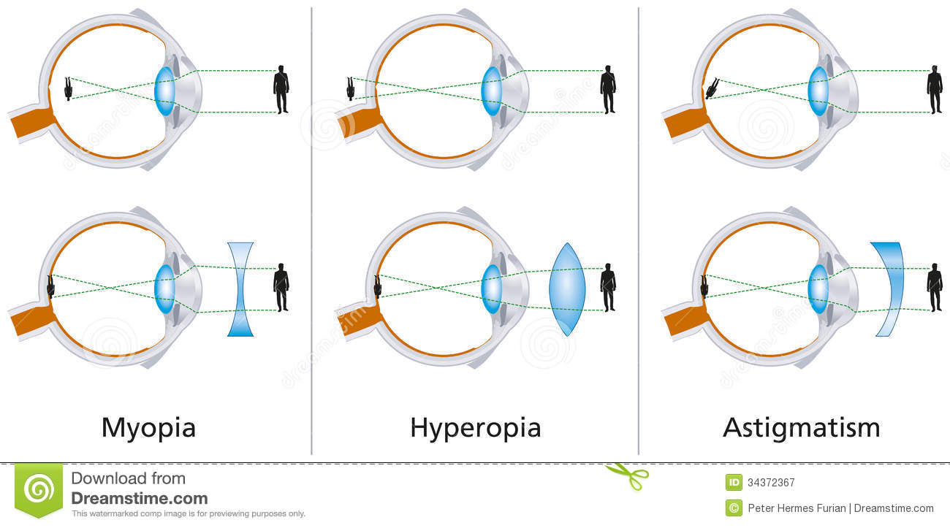

Slide 6
Far point and optical correction
If the retina of an eye is thought of as an object, the image of the retina created by the eye's optical system will be located at the far point plane. The far point denotes the location at which the far point plane intersects the optical axis. That point is conjugate to the fovea by any non accommodating eye.

Slide 7
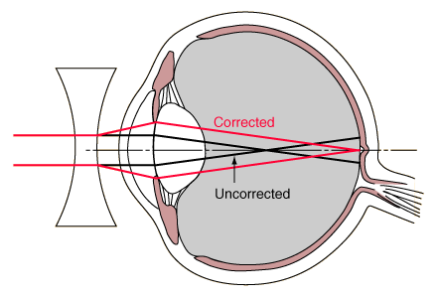
Far point plane in myopia coincides with the focal point of concave lens

Slide 8
3) Lens effectivity
Almost any lens can become a corrective lens if its secondary focal plane is placed to coincide with the ametropic eye's far point plane

Slide 9
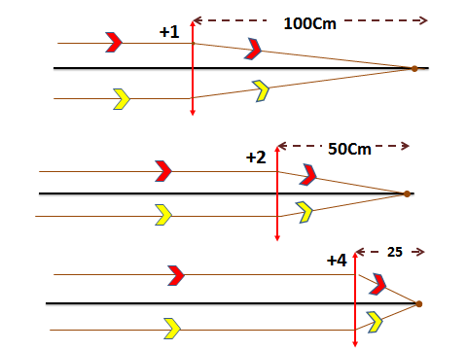

Slide 10
4) Effect of changing lens position:
If a given corrective lens is moved along the visual axis, its effectivity is changed that means the image of a distant object created by the lens will no longer be coincident with the far point, which is fixed in position relative to the eye and so will result in blurring of retinal image.

Slide 11
+12
Far point
14 mm
Far point
83mm-14mm=69mm 1\69=+14

Slide 12
Correction of myopia
Basic optics.
Full versus partial correction.

Slide 13
Basic optic
The far point plane of the myope is located at a certain plane in the front of the eye and determine the degree of myopia.
For the myope, all objects located further away from the far point plane will result in blurred retinal imagery. (For example 1 D myopia).
By definition, the lens that corrects a given degree of myopia images an object at the far point plane of the eye.

Slide 15
Full versus partial correction of myopia
To create a truly clear retinal image of a distant object, the full extent of myopia must be corrected. However several issues need to be considered:
Length of the examination room.
Night myopia.
Visual needs of the patient.
Corrected before or not.

Slide 16
Correction of hypermetropia
Basic optics.
Full versus partial correction.

Slide 17
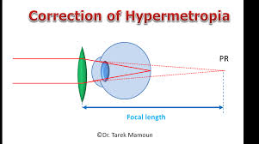
Basic optics
The far point of the hypermetropic eye is located behind the eye and so it is virtual.
A lens is corrective if its focal point coincides with the far point of the hypermetrope.

Slide 18
Full versus partial correction:-
Depends on:-
Patient age.
Degree of hyperopia.
Accomodation and binocular status.

Slide 20
Correction of astigmatism
Basic optics.
Full versus partial correction.

Slide 21
1) Basic optics
The astigmatic eye is unique in that it has two far points planes, one for each of the two principle meridians of thee refractive error.
Any object point complex bowtie shaped image (Conoid of Strum) with waste called circle of least confusion.

Slide 22
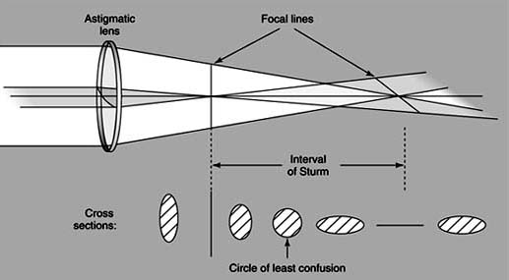
Conoid of Strum

Slide 23
For correction, cylindrical lenses are used, in compound and mixed astigmatism, spherocylindrical is used. With spherical equivalent of that lens is the spherical power that is dioptrically halfway between the highest and lowest of the principle meridia powers.
With the rule or against the rule.
Cannot achieve perfect retinal clarity by holding an object at any single position, as in myope or can use accommodation as in presbyope.
So the aim is to produce sharp retinal imagery.

Slide 24
2) Full versus partial correction of astigmatism.
Visual correction of the astigmate is not often as clear cut as myope or hyperope.
Spherocylinder produce magnification or minification disturbance in spatial orientation and athenopia.
The patient may adapt and if not maintain the spherical equivalent is used and reduce the amount of cylinder.

Slide 25
Effect of spectacle prescribing on accomodation
You should always consider how that refractive correction may affect the accommodative function of each patient, especially those with accommodative dysfunction or those with early or established presbyopia:
Myopes.
Hyperopes.

Slide 26
Effects on binocularity
Esophoric and esotropic patients.
Exophoric and exotropic.

Slide 27
Thank you

